Slide 1
Forecasting Study In
Diabetic Drugs Market
Hadiza Mamman
Yuchen Hsiao
Yu Ming
Notes:
Yu Ming

Slide 2
BACKGROUND
Notes:
Yu Ming

Slide 3
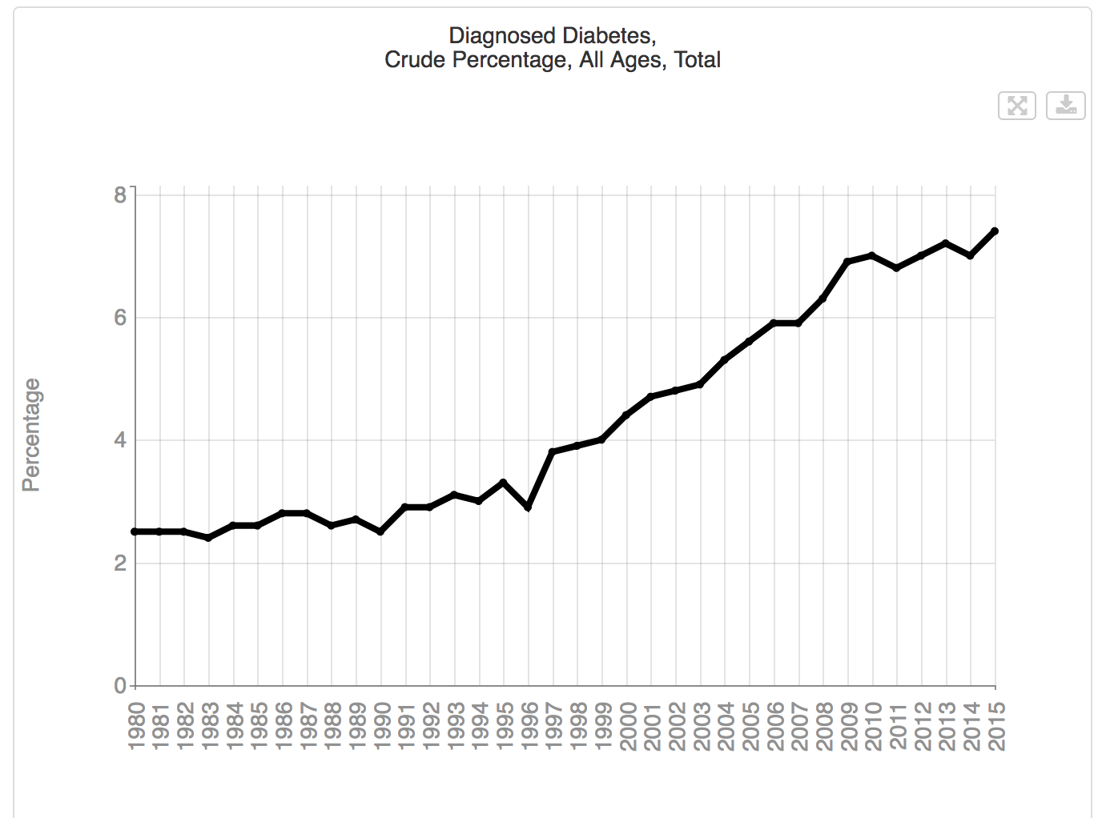
More than 30 million Americans have diabetes
The population of diabetic patients keeps increasing from 1980
Notes:
Yu Ming
As of 2018 more than 30 million Americans have diabetes – representing nearly 10 percent of our population.

Slide 4
Type 2
Diabetes
Accounts for 90% to 95% of all diabetes cases
The most common form of diabetes
Possible Treatments:
SGLT2 inhibitors
Insulin
DPP－4 inhibitors
Notes:
Yu Ming
Type 2 diabetes is the most common form of diabetes.
However, because type 2 diabetes accounts for 90% to 95% of all diabetes cases, the data presented are likely to be more characteristic of type 2 diabetes
possible treatments for type 2 diabetes
SGLT2 inhibitors.

Slide 5
Problem Statement
With the increasing population of diabetic patients, how do the sales of diabetes drugs compare and why? What will their future development trend be?
Notes:
Hadiza
With the increasing population of diabetic patients, how do the sales of diabetes drugs compare and why? What will their future development trend be?
rising prevalence of diabetes across the globe is expected to drive the global SGLT2 inhibitors market.

Slide 6
Goals/Objectives
Analyze past and current demand and the sales performance in SGLT2 inhibitors，insulin, and DPP-4 inhibitors markets.
Analyze their competitors and substitutes from other markets.
Find the competitive advantages of SLGT2 inhibitors，insulin, and DPP-4 inhibitors treatments.
Perform demand forecasting studies on SGlT2 inhibitors, DPP-4 inhibitors, and insulin markets to find their future trends.
Notes:
Hadiza

Slide 7
SGLT2 Inhibitors
Notes:
Yu Ming (First, I’d like to introduce SGLT2 inhibitors market)

Slide 8
SGLT2 inhibitors
(Sodium glucose cotransporter-2)
The newest class of oral antihyperglycemic agents
Significant developments in safety and efficacy
High Consumption:
Simple treatment method
Relatively better results
Preferred line of treatment
Canagliflozin(Invokana)
Dapagliflozin(Farxiga)
Empagliflozin(Jardiance)
Notes:
Yu Ming
sodium glucose cotransporter-2
SGLT2 inhibitors are the newest class of oral anti-hyperglycemic agents that have been approved for the treatment of diabetes mellitus. Over the past year there have been significant developments in both the safety and efficacy of this class of medications that are presented in this review.
SGLT2 inhibitors are expected to have high consumption in the near future due to simple treatment method and relatively better results and preferred line of treatment for type II diabetes.
canagliflozin(Invokana)
empagliflozin(Jardiance)
dapagliflozin(Farxiga)

Slide 9
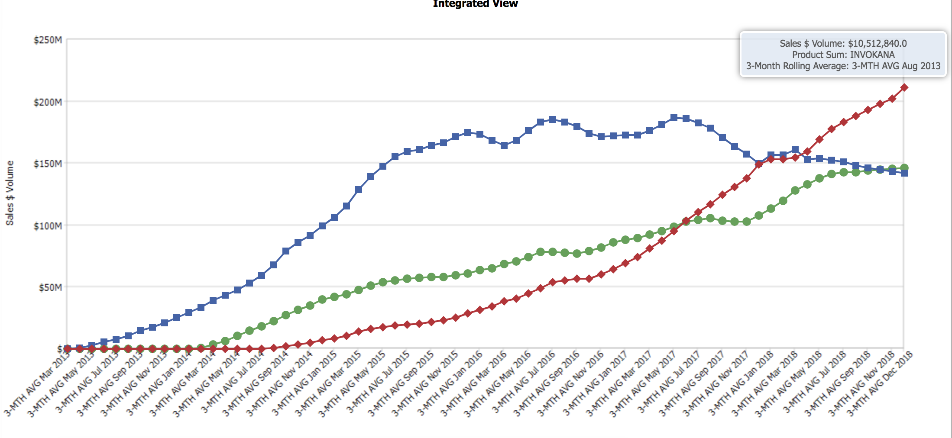
THE SALE REVENUE OF INVOKANA(BLUE), FARXIGA(GREEN), JARDIANCE(RED)
Invokana
Farxiga
Jardiance
Notes:
Yu Ming (https://www.fool.com/investing/general/2015/03/21/this-is-why-diabetes-treatment-costs-are-soaring.aspx)
In 2013, Johnson & Johnson's (NYSE:JNJ) Invokana became the first SGLT2 inhibitor.In January 2014, the FDA approved sales of AstraZeneca's (NYSE:AZN) Farxiga; 2014 August, the agency gave the go-ahead to Jardiance from Boehringer and Eli Lilly and Co. (NYSE:LLY).
Despite having to compete for prescriptions with those two new SGLT2 drugs, management reports that its Invokana market share improved to 6.5% in the fourth quarter from 6.3% in the third quarter. Since Jardiance and Farxiga haven't dented Invokana's prescription trend, it appears that their approval has only served to strengthen the case for using SGLT2 inhibitors more widely. However, since 2015 to 2019, the trends of these three have changed a lot. we will talk about the reasons in the next couple of slides.
The sale of Invokana (blue), Farxiga (green), Jardiance (red)

Slide 10
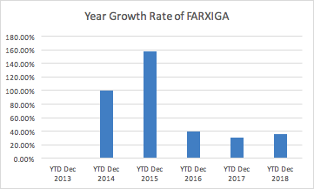
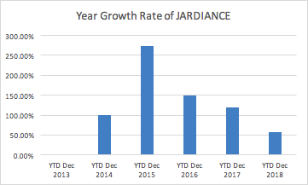
Data Summary
Notes:
Yu Ming
I created a bar chart of the year growth rate of these three drugs, so that we can look at the trend of the sales in these years.
Here is the year growth of Farxiga and Jardiance , although Farxiga come in the market several month before Jardiance. But it did not grow as fast as Jardiance. Especially in 2015,

Slide 11
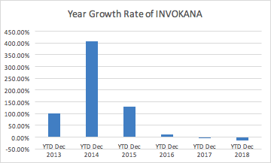
Data Summary
400%
Notes:
Yu Ming

Slide 12
INVOKANA
Reasons of decline in sale:
Label: higher risk of leg and foot amputation
Give competitors chance
Higher discounts for managed care contracting
More sales coming from the Medicaid channel
Notes:
Hadiza(https://www.forbes.com/sites/greatspeculations/2017/05/18/understanding-jjs-risk-from-new-fda-label-warning-for-invokana/#4537253a7c79)
the FDA gave a jolt to Johnson & Johnson‘s diabetes business when it concluded that J&J must include a label warning that patients using its diabetes drug Invokana are at a higher risk of leg and foot amputation.The addition of the FDA’s boxed warning makes it fairly unlikely that Invokana’s sales will rebound significantly. Give J&J’s competitors ample ammunition to push their drugs in the market.
In fact, the first quarter of 2017 saw more than a 10% decline in sales, which was primarily due to lower prices, which resulted from higher discounts for managed care contracting and more sales coming from the Medicaid channel, where pricing is lower.

Slide 13
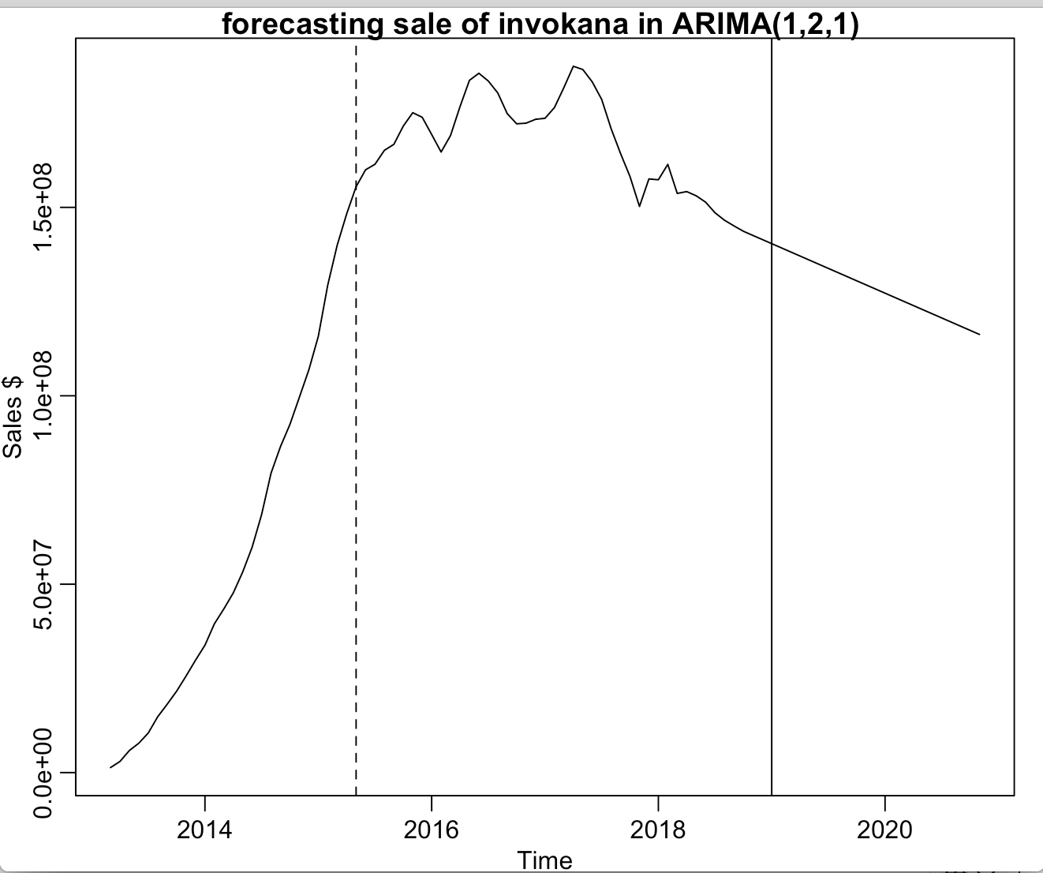
INVOKANA
(forecasting)
ARIMA(1,2,1)
Notes:
Yu Chen
Here is the forecasting sale of invokana for the next two years. The part that after the vertical line is the forecasting part.
In the beginning, we use the entire dataset to do the model fitting, but the result of the forecasting decrease faster as time go by, which may be affected by the beginning part. Therefore, we cut the data in April in 2015, which is the dashed vertical line, so it can avoid the part that increase rapidly and fit the dataset with ARIMA(1,2,1) model.
Also, the model with cutted data has lower AIC than the model with original data. As a result, we think that the model with cutted data can predict more precise.
And as the chart showed, the sale of invokana will decrease in next two years

Slide 14
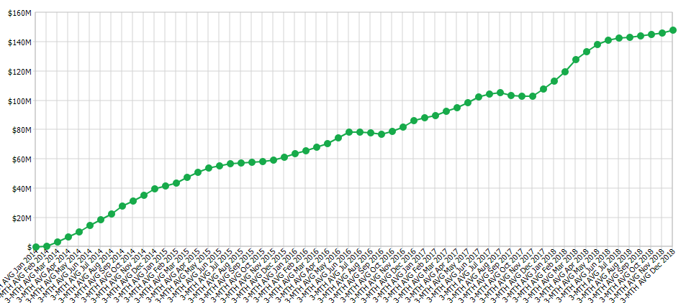
FARXIGA
Won FDA approval in January 2014
Was Invokana’s first competitor in the SGLT2 field
DECLARE-TIMI 58: have favorable effects on several cardiovascular risk factors
Notes:
Yu Ming （https://www.biopharmadive.com/news/astrazeneca-cvd-real-sglt2-diabetes-farxiga/438425/）
AstraZeneca's ($AZN) Farxiga (dapagliflozin) won FDA approval in January 2014, and was Invokana's first competition in the SGLT2 field。
there is no data yet showing that they decrease cardiovascular risk.
AstraZeneca has its own large cardiovascular outcomes trial, dubbed DECLARE, currently underway, aimed at showing a similar benefit to Farxiga. Results are expected in 2019 at the latest.
And Jardiance's new label for cardiovascular benefit could prove a competitive edge until AstraZeneca's DECLARE study delivers positive results.
had favorable effects on several cardiovascular risk factors

Slide 15
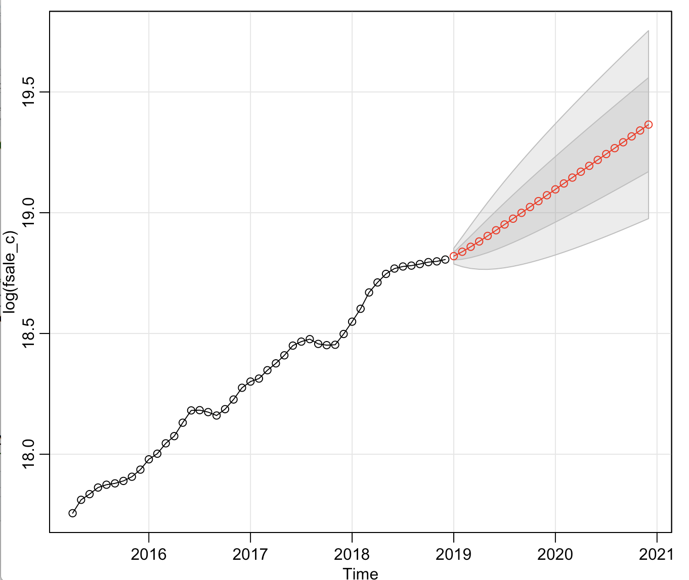
FARXIGA
ARIMA(1,1,0)
Notes:
Yu Chen
Here is the forecasting sale of farxiga with the log transformation.
When we use the entire dataset to do the model fitting, the forecasting of sale will go up a little and start to falling, which is weird, so we cut the dataset to and fit with the ARIMA (1,1,0) model. And that is why the data in this chart started from April in 2015

Slide 16
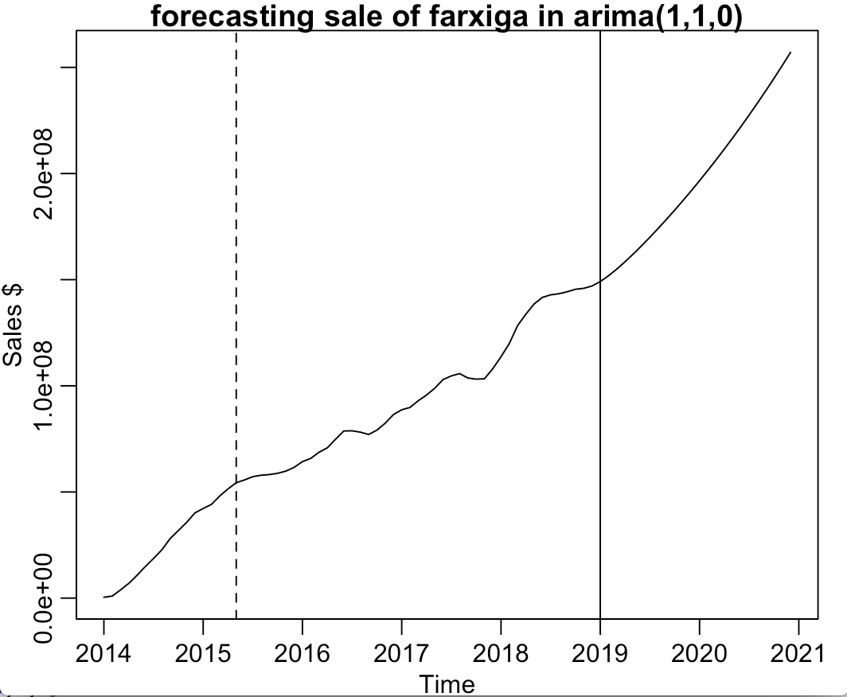
FARXIGA
ARIMA(1,1,0)
Notes:
Yu Chen
Here is the forecasting sale of Farxiga after removing the log transformation.
Here is the forecasting part of sale in next 2 years. It showed that as the time goes by, the sale will rise faster

Slide 17
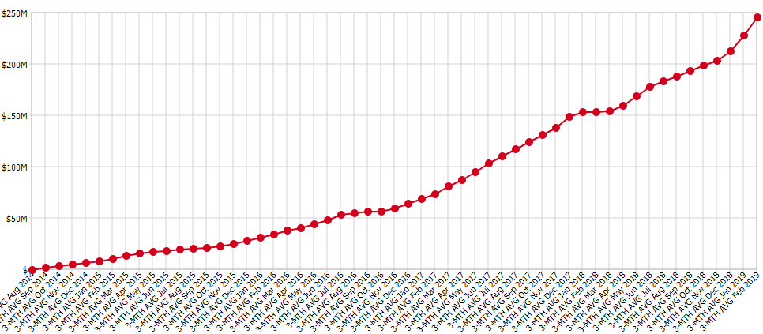
JARDIANCE
Label: Cardiovascular benefit
Reduced the overall risk of having a heart attack or stroke, or of dying from cardiovascular causes, by 14%
Cut cardiovascular death by 38%
Notes:
Yu Ming(https://www.nytimes.com/2015/09/18/business/jardiance-a-diabetes-drug-is-shown-to-reduce-cardiovascular-deaths.html)
And Jardiance's new label for cardiovascular benefit could prove a competitive edge until AstraZeneca's DECLARE study delivers positive results.
reduced the overall risk of having a heart attack or stroke, or of dying from cardiovascular causes, by 14 percent. Looking only at cardiovascular deaths, the reduction was 38 percent. shown a one-third reduction in the risk of cardiovascular death.Because cardiovascular disease is the leading cause of death for people with diabetes, he said, reducing that rate “by 38 percent is a landmark result.” The findings could hurt sales of some other types of diabetes drugs, including the Merck blockbuster Januvia.

Slide 18
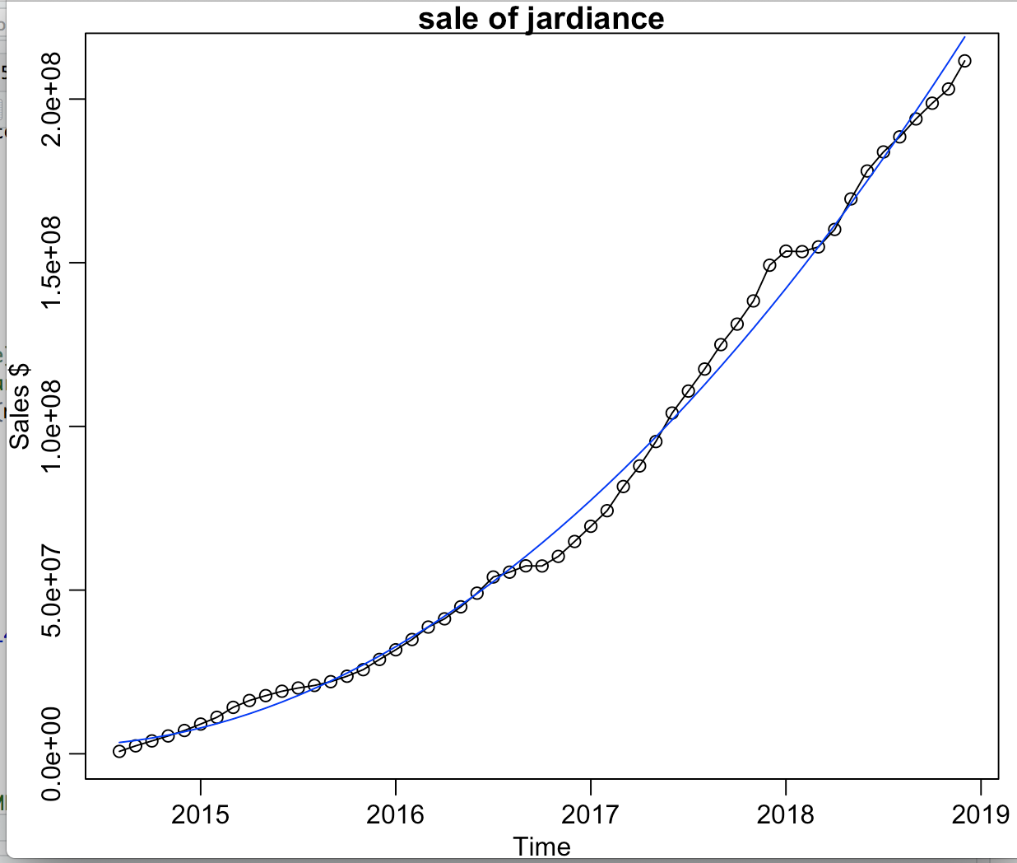
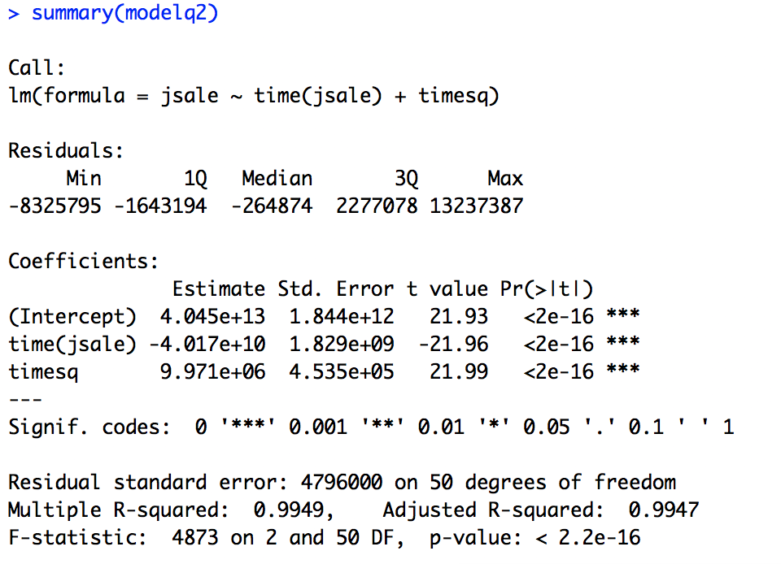
JARDIANCE
sale=4.045*10^13-4.017*10^10*time+9.971*10^6*time^2
Notes:
Yu Chen
Here is the model fitting for the sale of jardiance
We fit the dataset with the quadratic regression model, which is the equation that I showed on the upper left corner
We can see the p-value of both two coefficient and intercept are smaller than 0.05, which means that three of them are significantly different from 0
Also, the r square here is about 0.99, which means that the model fits very well with the dataset

Slide 19
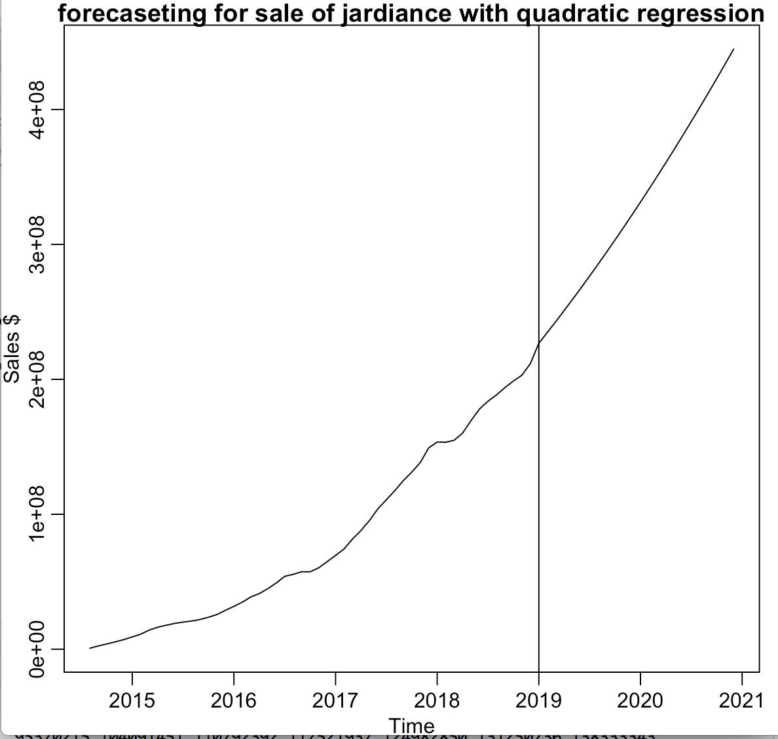
JARDIANCE
(Forecasting)
Notes:
Yu Chen
Here is the forecasting sale of jardiance for the next two years.
As the picture showed, the sale will increase faster as time go by
the 38% reduction in cardiovascular death the med

Slide 20
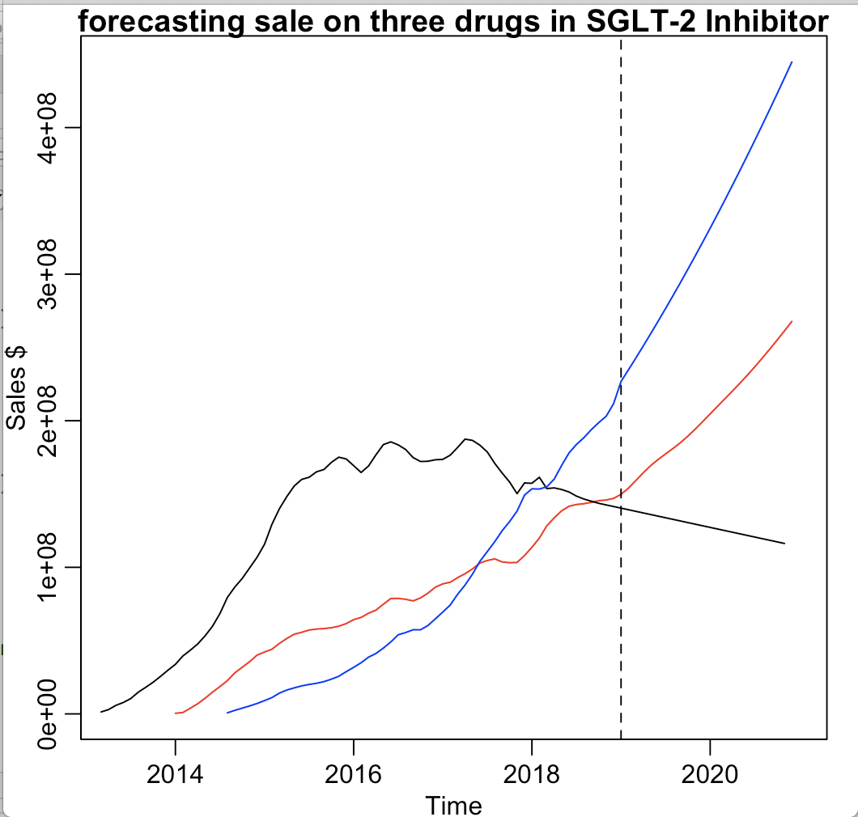
Sglt2 inhibitors
(Forecasting)
jardiance : blue farxiga: red invokana: black
Notes:
Yu Chen
Here is the forecasting sale of three drugs in sglt2 inhibitor.
The result show that the jardiance and farxiga is trying to capture the market share of invokana
And the jardiance get the most of market share in SGLT2 inhibitor group

Slide 21
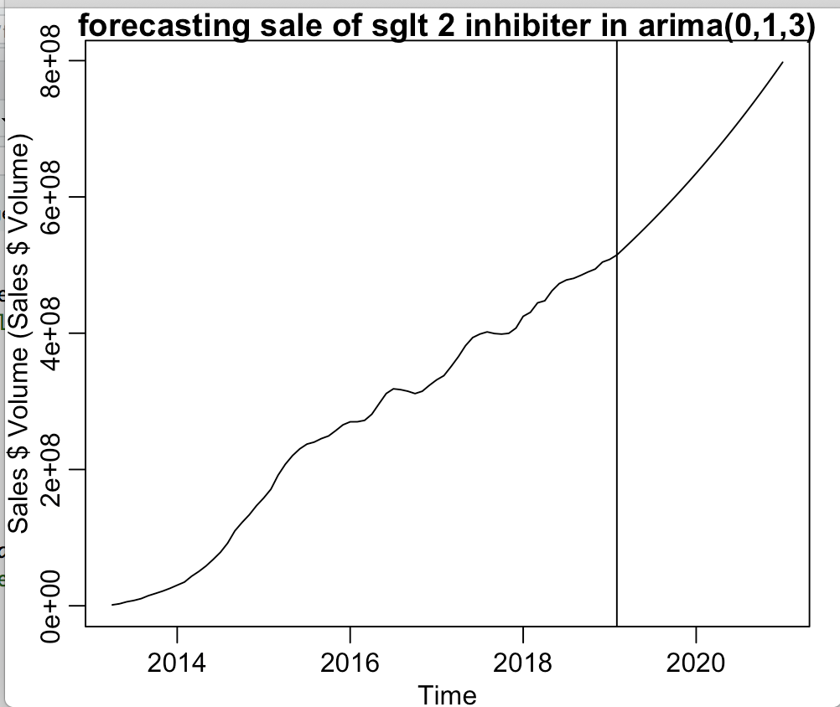
SGLT2 inhibitors
ARIMA(0,1,3)
Notes:
Yu Chen
Here is the total sale of three drugs in sglt2 inhibitor group, we fit data with arima(0,1,3) and the forecasting show that the sale in next two year is increasing
Also, to avoid the part that increase rapidly, we only use the data after MAY IN 2015

Slide 22
INSULIN
Notes:
Hadiza

Slide 23
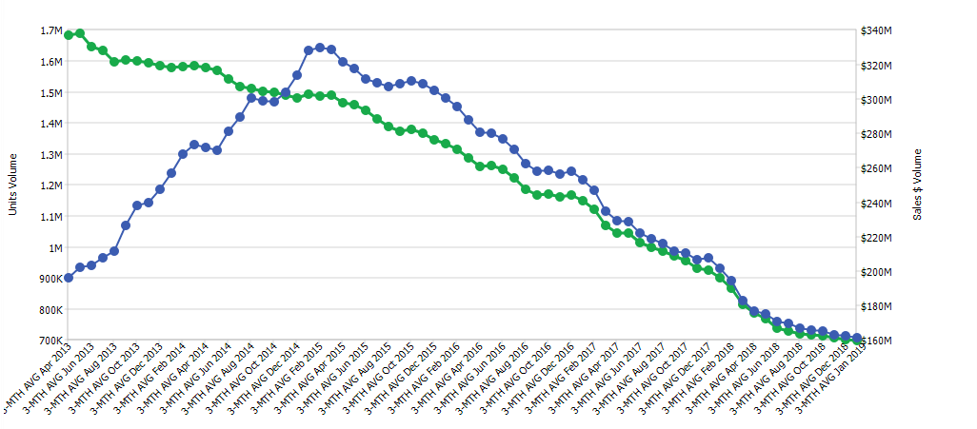
Insulin
Unit Volume
Sales $ Volume
The sale unit volume(green) v.s sale revenue(blue) of Lantus
Notes:
Hadiza: talk about the green line, which indicates the sales units drop from 1.7 M to 700K, and the blue line, 200M to 320 M to 160M
The sales of insulin are steeply declining because people cannot afford it anymore.
Growth of drug Tresiba 2015, emergence of similar drugs. GLP-1 drug Ozempic once a week it 15 to 30 minutes before a meal. I

Slide 24
Insulin
Drugmakers have increased the price of insulin by nearly 300% from 2002 to 2013.
From 2012 to 2016, the price of insulin increased from 13 cents a unit, to 25 cents a unit.
Notes:
Hadiza
Payment incentives, outdated patent regulations, and other factors
current rebate system provides an incentive for PBMs ( administer prescription drug plans for more than 266 million Americans who have health insurance from a variety of sponsors)
to accept high-priced drugs. drugmakers pay PBMs rebates in exchange for a spot on a formulary, which is a list of drugs covered under a health plan. As a result, drugmakers can set high list prices, but PBMs will not pay the prices because of the discounts. & uninsured patients end up paying the high list prices.

Slide 25
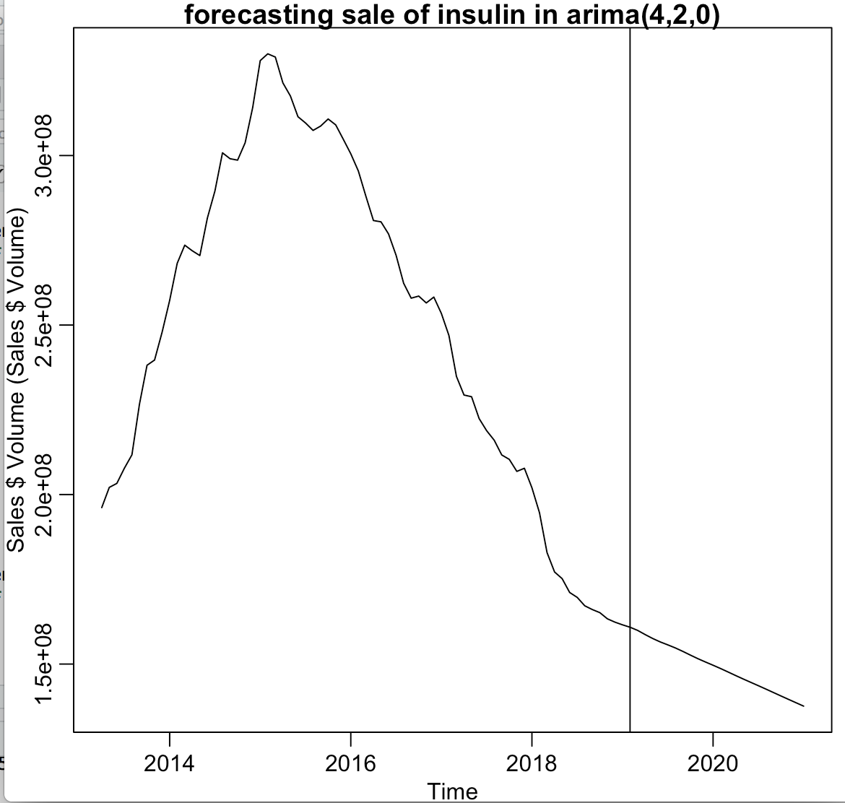
Insulin
(Forecasting)
arima(4,2,0)
Notes:
Hadiza
Reports of children dying because they cant afford insulin.

Slide 26
Short term solutions
Crossing borders to get cheaper insulin
Black market & trading prescriptions via social media
Rationing insulin
Notes:
Hadiza
Southern California mainly LA to Tijuana. 45 minute drive. A 3 month supply on average cost $3700. In Tijuana, it’s $600
Trades on Facebook based on insurance coverage. Offer to swap supply of the drug their insurance covers with ppl who may have coverage of the brand they’re looking for.
ISSUES: buying prescription drugs from strangers always a risk. Insulin must be stored or shipped at the right temperature.
Rationing is dangerous. (Minnesota example)$1300 for 4 vials without insurance. In a 10ml insulin, there is 1000 units. Earlier 25 cents for a unit.

Slide 27
DPP-4 Inhibitors
Notes:
Yu Ming
Merck & Co.'s (NYSE:MRK) Januvia, which got the nod in 2006, holds the distinction of being the first DPP-4 inhibitor to win Food and Drug Administration (FDA) approval. The second DPP-4 to get an OK was Onglyza in 2009, the third was Tradjenta,

Slide 28
DPP-4 inhibitors
(dipeptidyl peptidase-4)
DPP-4 Inhibitors
has the largest market share
Blocking the action of DPP-4
help regulate blood glucose levels
DPP-4 is an enzyme which destroys a group of gastrointestinal hormones called incretins.
Januvia
Onglyza
Tradjenta
Notes:
Yu Ming (https://www.diabetes.co.uk/diabetes-medication/dpp-4-inhibitors.html)
DPP-4 Inhibitors Segment Has the Largest Market Share in diabetic drugs market
They work by blocking the action of DPP-4, an enzyme which destroys a group of gastrointestinal hormones called incretins.
by protecting incretins from damage, DPP-4 inhibitors help regulate blood glucose levels.

Slide 29
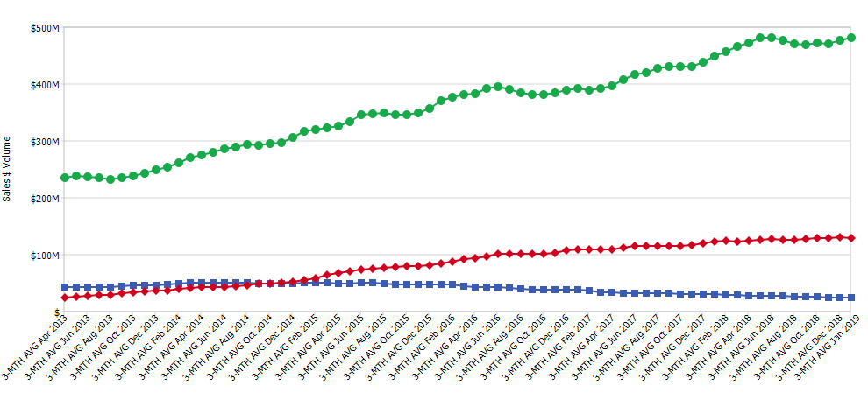
DPP-4
inhibitors
Januvia
Sales $ Volume
Tradjenta
Onglyza
Sale Revenues of Januvia(green),Onglyza(blue),Tradjenta(red)
Notes:
Yu Ming
Onglyza (decrease) (blue)saxagliptin Tradjenta(increase) (yellow)linagliptin Januvia(increase) (red)sitagliptin

Slide 30
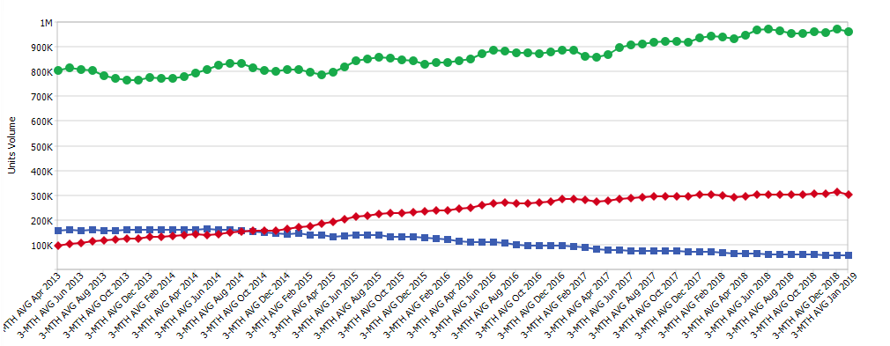
DPP-4
inhibitors
Januvia
Unit Volume
Tradjenta
Onglyza
Units sale of Januvia(green),Onglyza(blue),Tradjenta(red)
Notes:
Yu Ming
Although the sales revenue of Januvia is increasing, One thing that we find interesting is the units sale of Januvia is flat. The reason of this sale performance is because Merck had raised the price of Januvia by more than 18% from January 2017 to mid-2018.

Slide 31
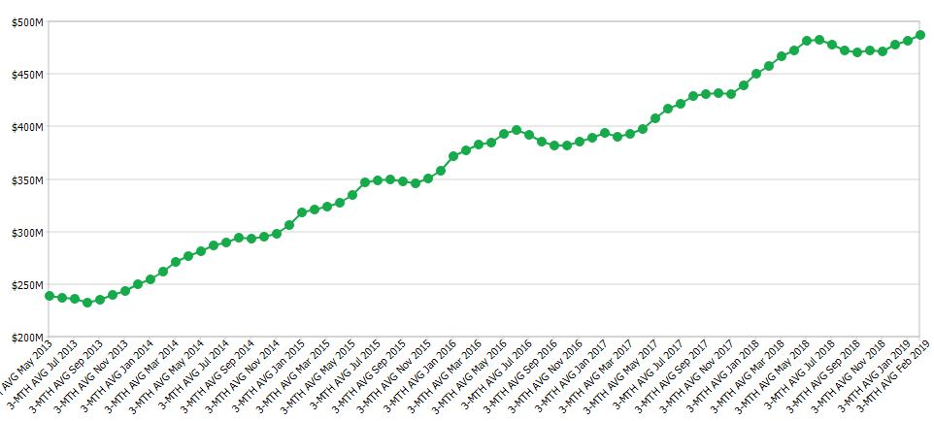
DPP-4
inhibitors
Januvia:
First DPP-4 inhibitors reach the market (2006)
Price of Januvia increased more than 18%
But units sale also increases
Notes:
Yu Ming(https://www.fool.com/investing/2018/07/20/eli-lilly-scores-a-win-in-diabetes.aspx)
Januvia has been on the market since 2006. It is the first DPP-4 to reach the market, One of the advantages of hitting a market first is the chance to get ahead with payers, and Januvia has racked up solid coverage
Merck had raised the price of Januvia by more than 18% from January 2017 to mid-2018, Patients continue to struggle to afford the drugs. However, the sale revenue and sale units did not decrease, but increase. We can see the trends of these three factors from next two slides
That doesn't mean there isn't room for other SGLT2 meds

Slide 32
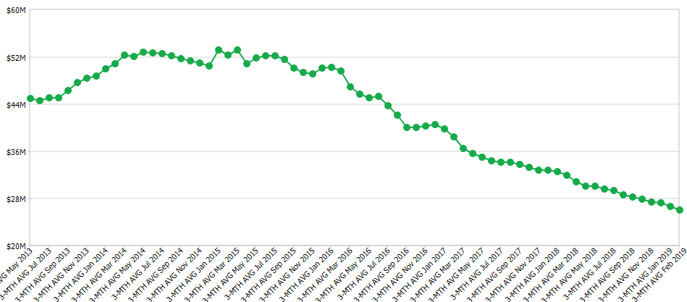
DPP-4
inhibitors
Onglyza:(2009)
Second DPP-4 inhibitors
Heart failure risks
Notes:
Yu Ming
Merck & Co.'s Januvia success has been helped by heart failure risks that in cardiovascular safety studies for Onglyza and Nesina.

Slide 33
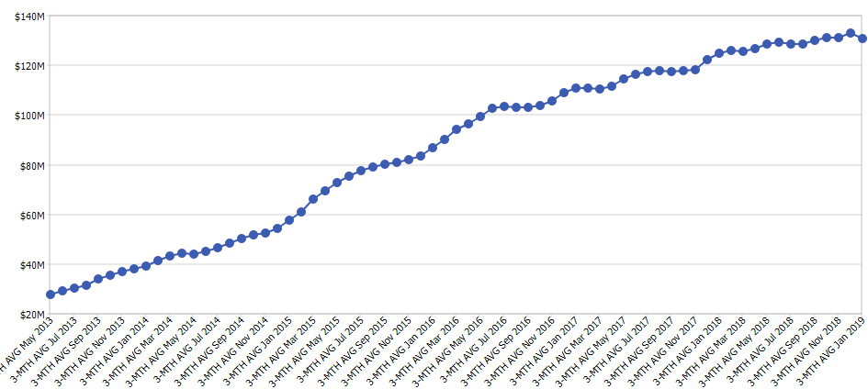
DPP-4
inhibitors
Tradjenta:(2011)
Does not increase the risk of cardiovascular events
Help to capture a greater share in DPP-4 market
Notes:
Yu Ming
Eli Lilly (NYSE:LLY) just unveiled new data showing that one of its diabetes drugs -- Tradjenta -- doesn't increase the risk of cardiovascular events, including heart attack and stroke. The results could help Tradjenta capture a greater share of the multibillion-dollar DPP-4 class of diabetes drugs, so let's learn more about it. Tradjenta’s safety data is good news for Eli Lilly because at a minimum, it levels the playing field with Januvia, and that could be enough to allow Tradjenta to chip away at more of Januvia's sales lead.

Slide 34
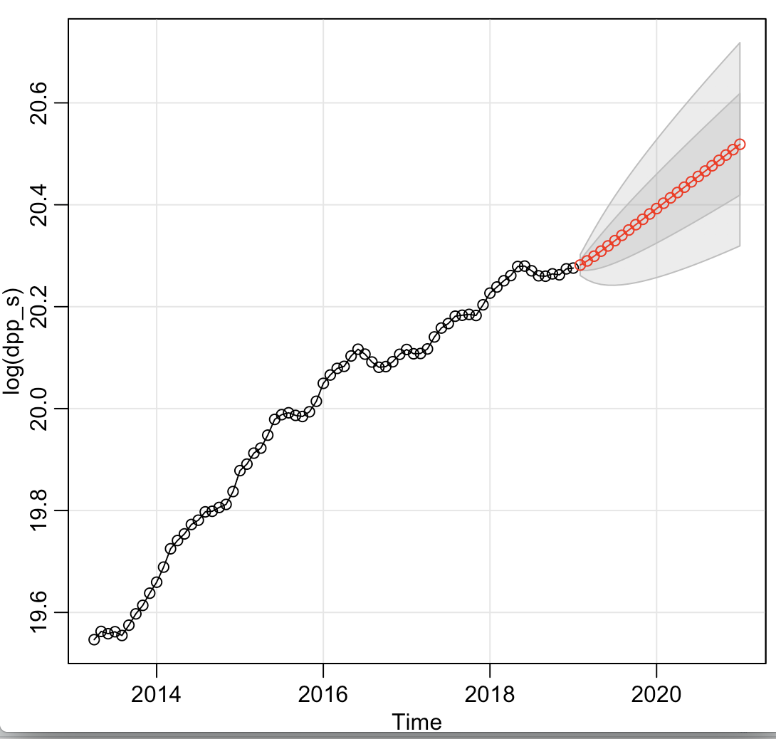
DPP4
Inhibitors
Arima(1,1,0)
Notes:
Yu Chen
Here is the forecasting sale of DPP4 inhibitors group with log transformation.
Fit the model with arima(0,1,2) and arima(1,1,0), since arima(1,1,0) has lower aic, so we choose this model to fit our dataset

Slide 35
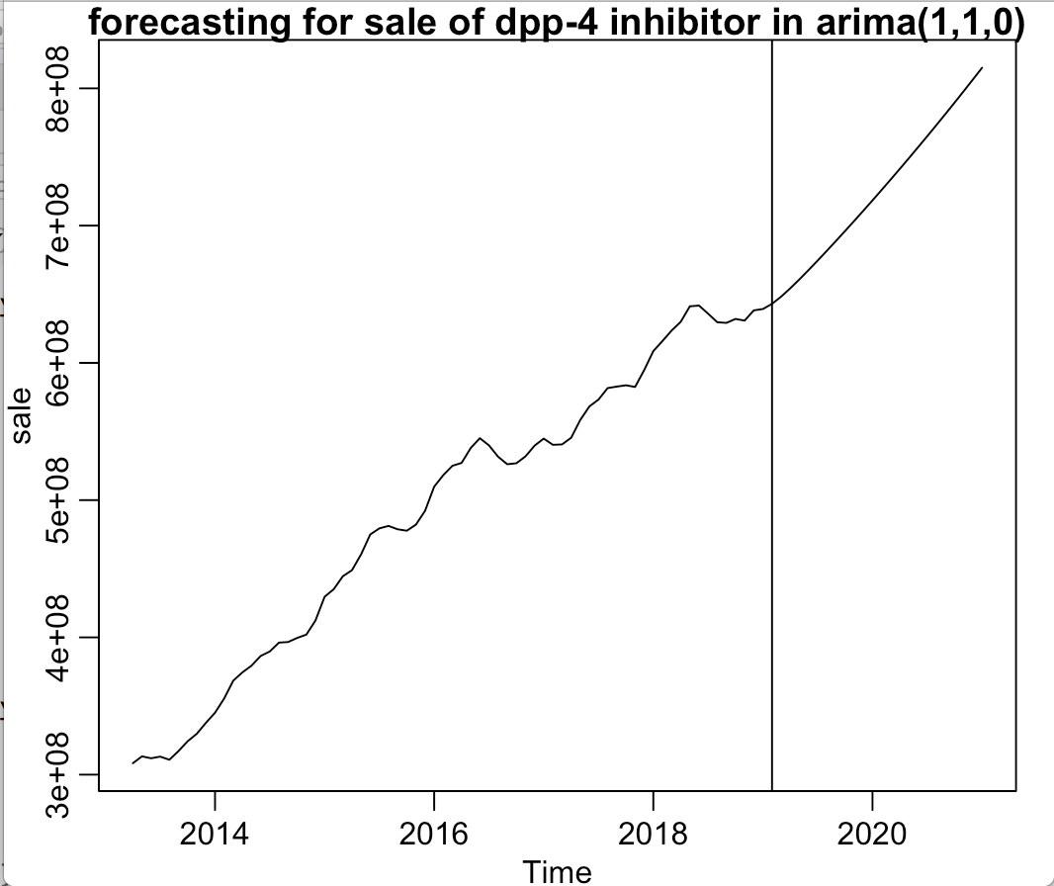
DPP4
Inhibitors
(forecasting)
Notes:
Yu Chen
Here is the forecasting sale of DPP4 inhibitor after removing the log transformation
And the sale of DPP4 inhibitors will increase in next 2 years

Slide 36
Competitive Advantages of Three Markets
 | SGLT-2 Inhibitor | DPP-4 Inhibitor | Insulin
Advantage | Reduce the risk of Heart attack, stroke, and weight gain | Don’t cause weight gain and hypoglycemia | Effective if the dose is proper
Disadvantage | May cause vaginal yeast infection, urinary tract infection | May cause joint pain and pancreatitis | Weight gain and hypoglycemia
Notes:
Yu Chen
To conclude, we have summaried the competitive advantage of three markets
The pros of SGLT2 inhibitor is that it can reduce the risk of heart attack, stroke. Also, it is helpful for reducing the weight
SGLT2 don’t affect the insulin directly
Instead, when urine is being formed,SGLT2 prevent the kidneys from absorbing glucose (sugar) back into the body so it cause the higher concentration of sugar in the urine, which can lead to an increased risk of urinary tract and yeast infections
For the DPP4 inhibitor, it won’t cause the weight gain problem and the issue of hypoglycemia, but it may cause the joint pain and pancreatites
Insulin is effective when it is used in the proper dose, but it may lead to weight gain and hypoglycemia
Hypoglycemia: low blood sugar

Slide 37
CONCLUSION
Notes:
Yu Ming

Slide 38
Analyze
Complex and competitive
Uncontrollable Factors
Side Effects
Invokana
Onglyza
Positive Research
Jardiance
Farxiga
Tradjenta
New competitors
Notes:
Yu Ming

Slide 39
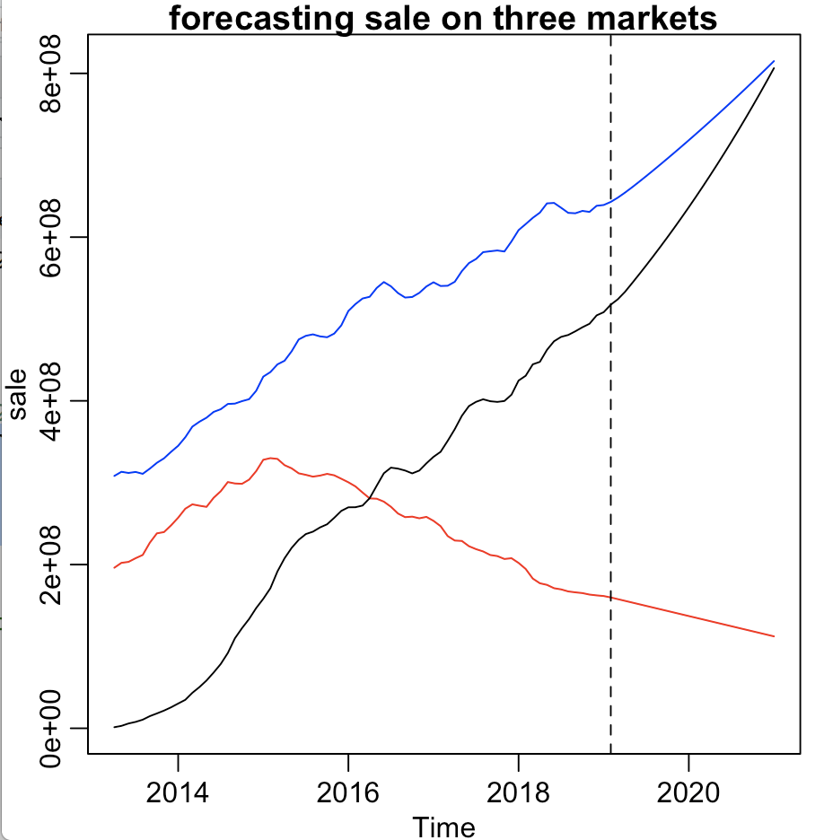
Forecasting
Insulin: red SGLT-2 inhibitor: black DPP-4 inhibitor: blue
Notes:
Yu Chen
Base on the past and current sale performance
The sale of SGLT2 inhibitor is chasing after the sale of DPP-4 inhibitors and may exceed the DPP-4 in the future
The market share of insulin in the diabetic drug market is falling down gradually

Slide 40
Verify
DPP-4 and SGLT2 inhibitors compete and coorperate
Competitive advantages
DPP-4 and SGLT2 inhibitors can be used as monotherapy or combination therapy
The combination therapy
has complementary effect in pharmacology.
Can inhibit glucagon and simulate insulin secretion.
Insulin: red SGLT-2 inhibitor: black DPP-4 inhibitor: blue
Notes:
Yu chen
We also find more research to support our result, we find out that DPP4 inhibitors and SGLT2 inhibitors does not only compete with each other, but also cooperate with each other.
As the competitive advantage that we mentioned before, there is competition between them.
For the relationship of cooperating, we found that DPP4 inhibitor and SGLT2 inhibitor can be used alone or they can be used together as a combination therapy
The combination therapy has complementary effect in pharmacology
For example: it can inhibit glucagon and simulate the insulin secretion, which cause a additional glucose-lowering effect than using SGLT2 OR DPP4 alone.
Since the combination of SGLT2 AND DPP-4 is safe and more efficacious, that may be one reason that the sale of both SGLT2 inhibitor and DPP4 inhibitor will increase together
Since this combination theory can simulate the insulin, that may be one of reason that the sale of insulin decrease
Moreover, since the population

Slide 41
C
O
N
C
L
U
S
I
O
N
Insulin: red SGLT-2 inhibitor: black DPP-4 inhibitor: blue
Notes:
YU CHEN
Due to the connection between three groups of drug that i mentioned from the previous slide, we believe that our forecasting result is reasonable
Moreover, we believe that the DPP4 inhibitor and SGLT2 inhibitor will have good development in the future

